Slide 1
Machine Learning for Neuroscience
Convolutional Neural Networks
Payam Barnaghi
Department of Brain Sciences
Imperial College London
January 2023
Notes:
1

Slide 2
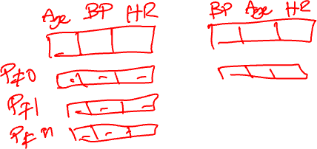
Feature Vectors
Image data is represented as a two-dimensional grid of pixels, be it monochromatic or in colour.
Each pixel corresponds to one or multiple numerical values respectively.
Until now most of the models that we have studied ignored this rich structure and treated the data as vectors of numbers.

Slide 3
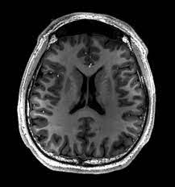

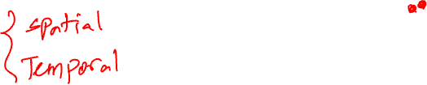
Images a vectors
Using images by flattening the images means overlooking the spatial relation between pixels.
This deeply unsatisfying approach could be a very simple solution in order to feed the resulting one-dimensional vectors through a fully connected MLP or other probabilistic models.

Slide 4
Feeding images to the models as blocks
Because the MLP networks are invariant to the order of the features, we could get similar results regardless of whether we preserve an order corresponding to the spatial structure of the pixels or if we permute the columns of our design matrix before fitting the MLP’s parameters.
Preferably, we would leverage our prior knowledge that nearby pixels are typically related to each other, to build efficient models for learning from image data.

Slide 5
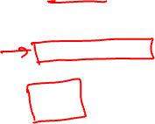
Convolutional Neural Networks
Convolutional neural networks or CNNs, are a specialised kind of neural network for processing data that has a known grid-like topology.
Examples include time-series data, which can be thought of as a 1-D grid taking samples at regular time intervals, and image data, which can be thought of as a 2-D grid of pixels.

Slide 6
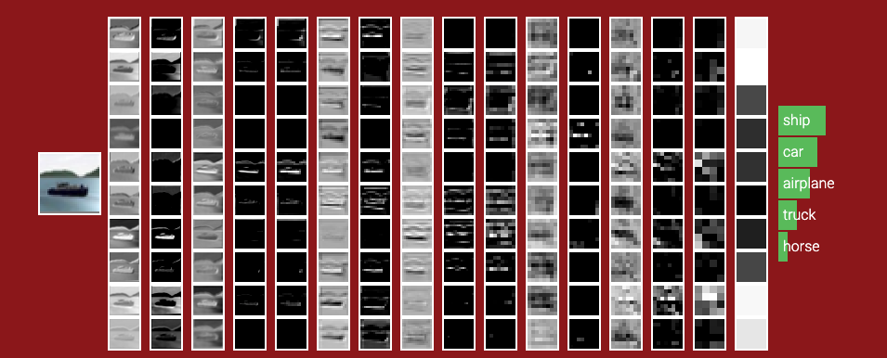
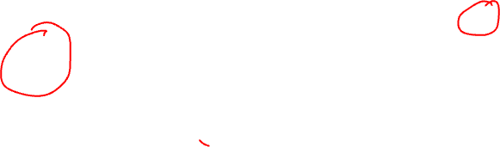
CNNs
image source: http://cs231n.stanford.edu/
We will revisit this again in the following slides.

Slide 7
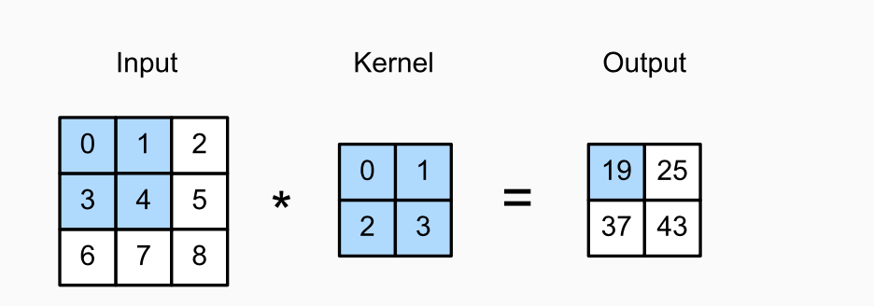
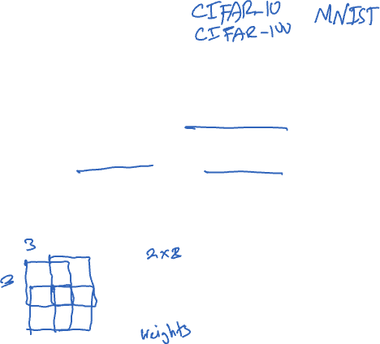
Convolution
Convolutional layers in CNN can be more accurately described as cross-correlations.
They take an input (which is usually a grid/subset of the main image/input) and overlay/apply a kernel.
The shape of the kernel window (or convolution window) is given by the height and width of the kernel.

Slide 8

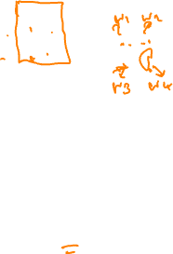


CNN kernels
$$\left(1×0\right)+\left(2×1\right)+\left(4×2\right)+\left(5×3\right)=25$$
$$\left(4×0\right)+\left(5×1\right)+\left(7×2\right)+\left(8×3\right)=43$$
$$\left(3×0\right)+\left(4×1\right)+\left(6×2\right)+\left(7×3\right)=37$$
Two-dimensional cross-correlation operation. The shaded portions are the first output element as well as the input and kernel tensor elements used for the output computation:
(0×0) + (1×1)+ (3×2)+ (4×3)=19.

Slide 9
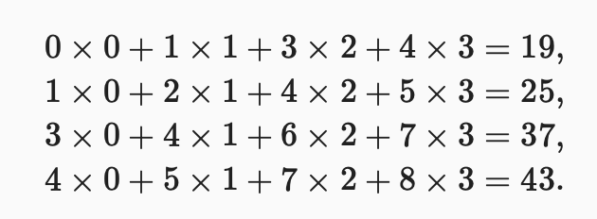
Sliding the kernel

Slide 10
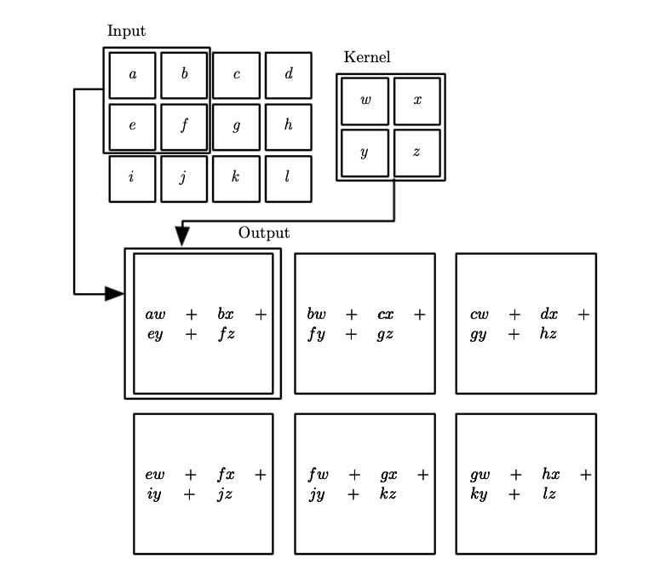

CNN – another example
Source: Deep Learning, Goodfellow et al., MIT Press.

Slide 11
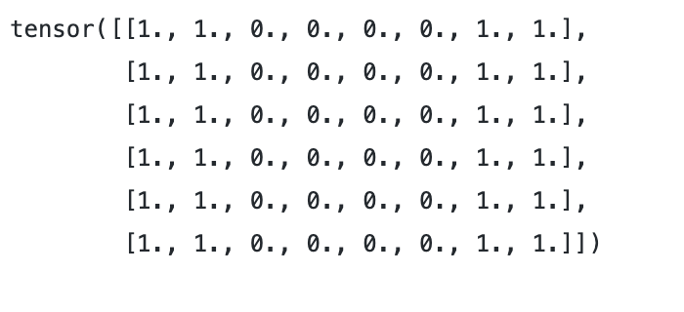
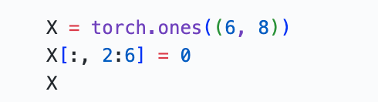

Example – edge detection: data
Code: GitHub - CNN_edge_detection_sample.ipynb

Slide 12
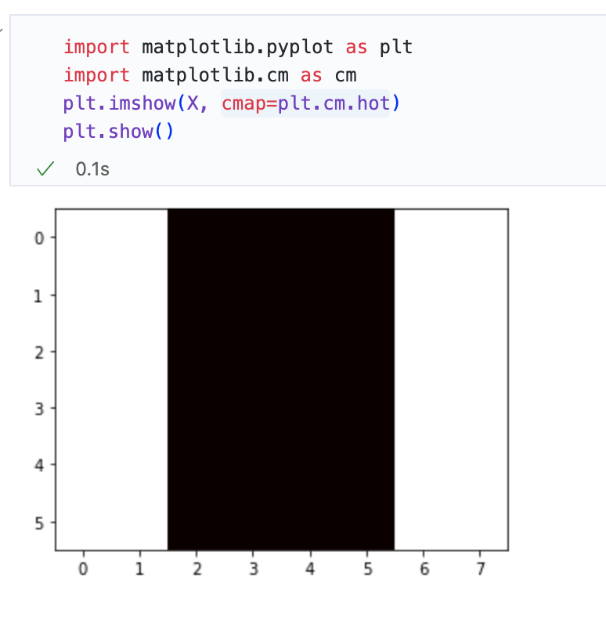
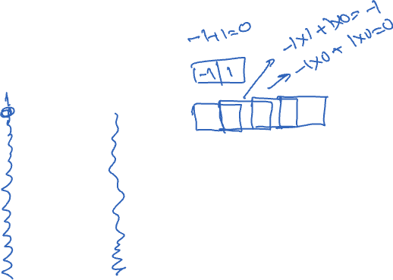
Example – edge detection: data

Slide 13

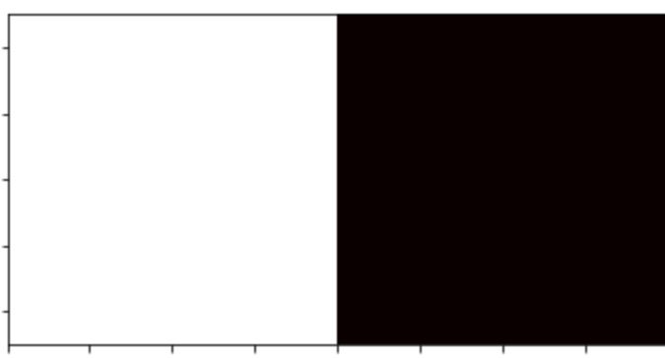
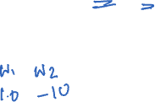
Example – edge detection: kernel
Code: GitHub - CNN_edge_detection_sample.ipynb

Slide 14
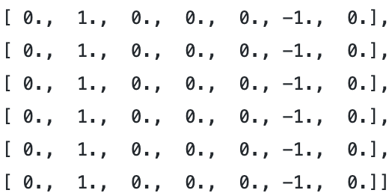
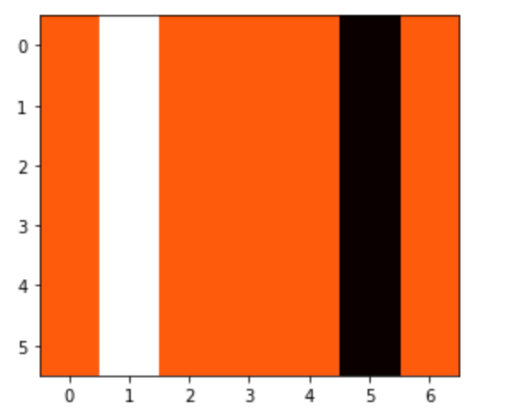
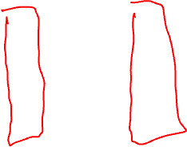
Example – edge detection: result
Code: GitHub - CNN_edge_detection_sample.ipynb

Slide 15
Learning a kernel
Designing an edge detector by finite differences [1, -1] is neat if we know this is precisely what we are looking for.
However, as we look at larger kernels, and consider successive layers of convolutions, it might be impossible to specify precisely what each filter should be doing manually.

Slide 16
Learning a kernel through training
We can learn the kernel that generated Y from X by looking at the input–output pairs only. We first construct a convolutional layer and initialise its kernel as a random tensor.
Next, in each iteration, we will use the squared error to compare Y with the output of the convolutional layer.
We can then calculate the gradient to update the kernel.

Slide 17
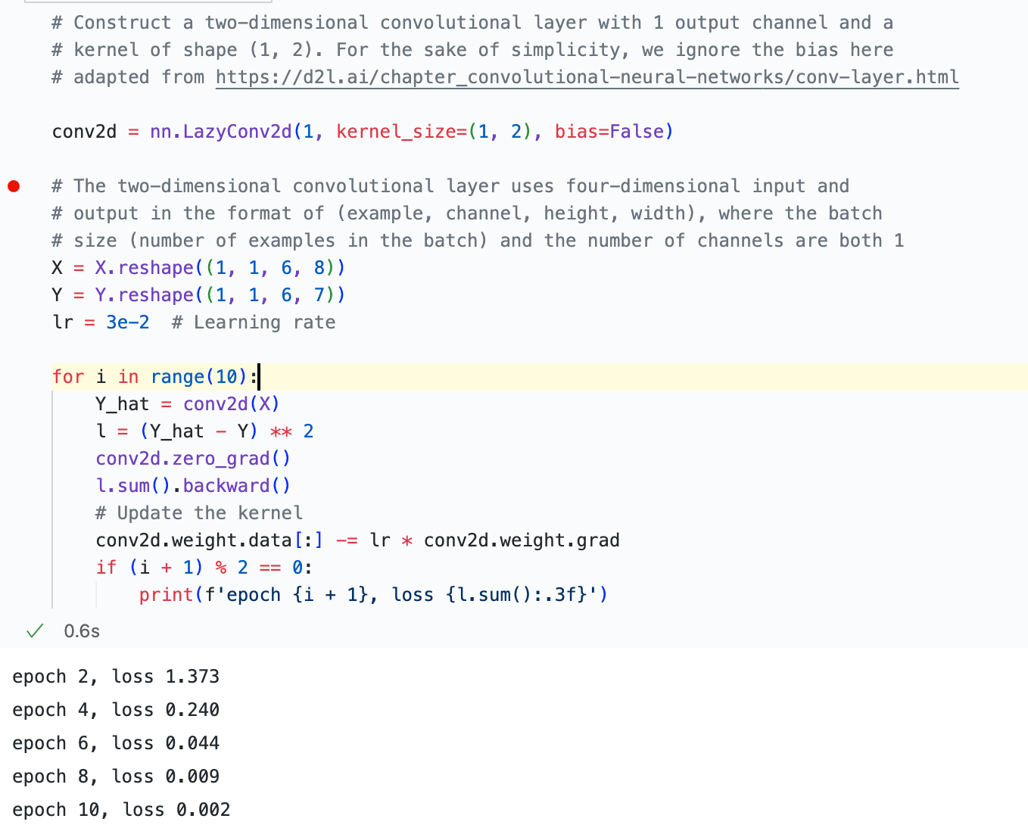
Example: how to learn a kernel
Code: GitHub - CNN_edge_detection_sample.ipynb

Slide 18
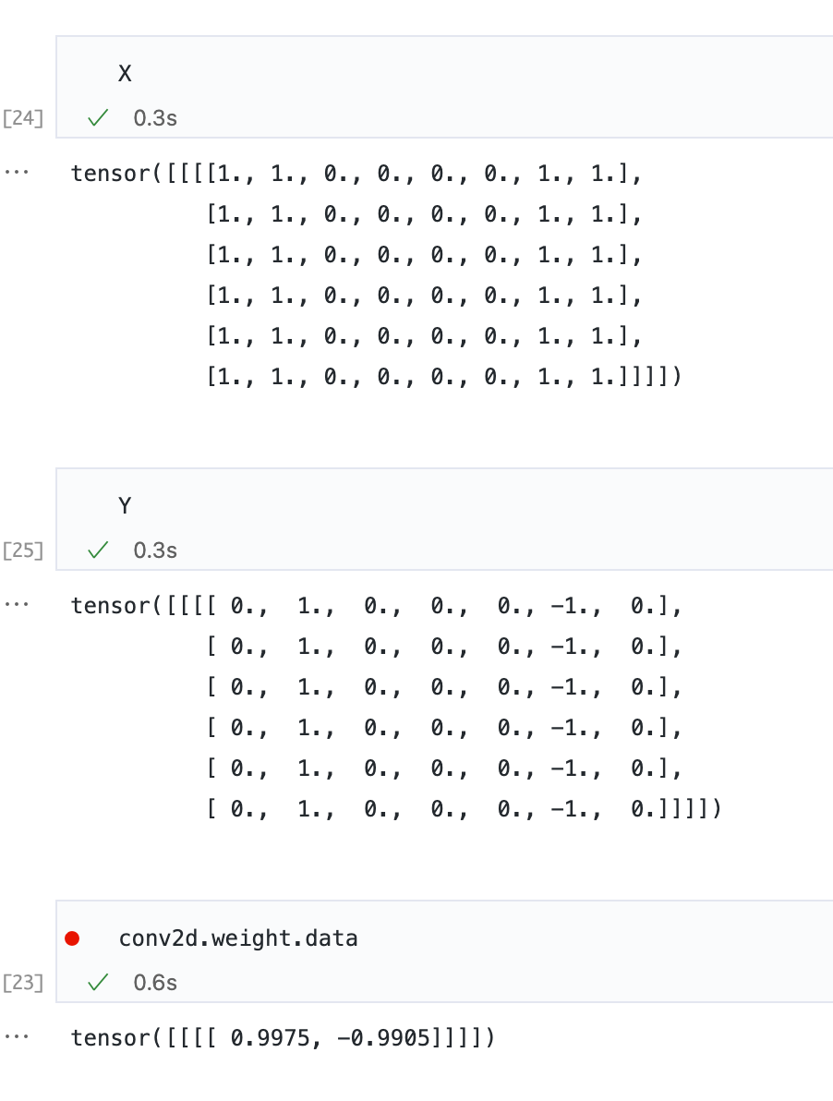
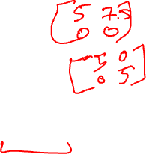
Example: how to learn a kernel: result

Slide 19
CNNs so far
The core computation required for a convolutional layer is a cross-correlation operation.
We saw that a simple nested for-loop is all that is required to compute its value.
If we have multiple input and multiple output channels, we are performing a matrix-matrix operation between channels.

Slide 20
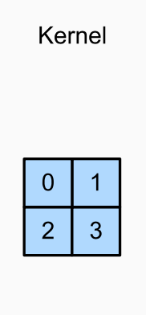
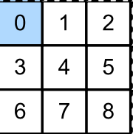
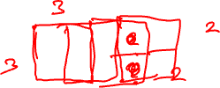
Padding and Stride
A tricky issue when applying convolutional layers is that we tend to lose pixels on the perimeter of our image.

Slide 21
Padding
Since we typically use small kernels, for any given convolution, we might only lose a few pixels, but this can add up as we apply many successive convolutional layers.
One straightforward solution to this problem is to add extra pixels of filler around the boundary of our input image, thus increasing the effective size of the image.
Typically, we set the values of the extra pixels to zero.

Slide 22
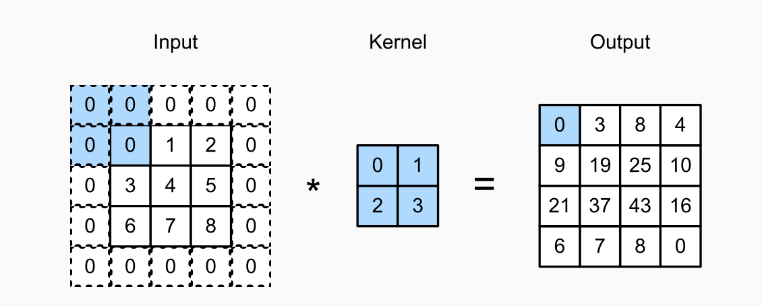
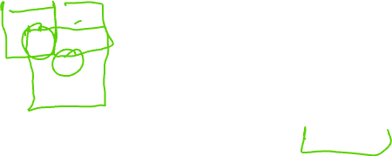
Padding: example

Slide 23

Choice of padding size
CNNs commonly use convolution kernels with odd height and width values, such as 1, 3, 5, or 7.
Choosing odd kernel sizes has the benefit that we can preserve the dimensionality while padding with the same number of rows on top and bottom, and the same number of columns on left and right.
For any two-dimensional tensor X, when the kernel’s size is odd and the number of padding rows and columns on all sides are the same, producing an output with the same height and width as the input.

Slide 24
Stride
When computing the cross-correlation, we start with the convolution window at the upper-left corner of the input tensor, and then slide it over all locations both down and to the right.
In the previous examples, we have been sliding one element at a time.

Slide 25
Stride
Sometimes, either for computational efficiency or because we wish to downsample, we move our window more than one element at a time, skipping the intermediate locations.
This is particularly useful if the convolution kernel is large since it captures a large area of the underlying image.
We refer to the number of rows and columns traversed per slide as stride.

Slide 26
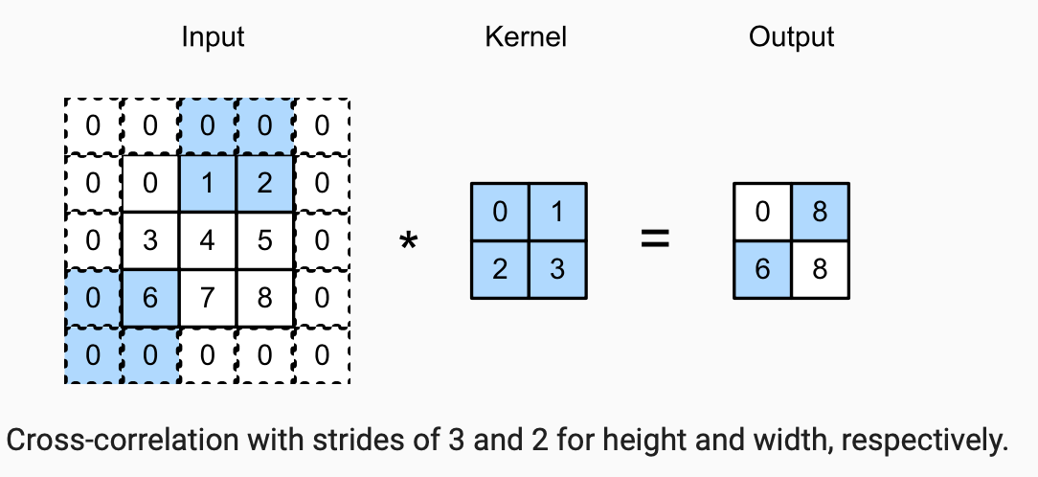
Stride: example

Slide 27

Choice of padding
Padding can increase the height and width of the output.
This is often used to give the output the same height and width as the input to avoid undesirable shrinkage of the output.
Moreover, it ensures that all pixels are used equally frequently. Typically we pick symmetric padding on both sides of the input height and width.

Slide 28
Multiple Input and Multiple Output Channels
While we described the multiple channels that comprise each image (e.g., colour images have the standard RGB channels to indicate the amount of red, green and blue) and convolutional layers for multiple channels.
When the input data contains multiple channels, we need to construct a convolution kernel with the same number of input channels as the input data, so that it can perform cross-correlation with the input data.

Slide 29
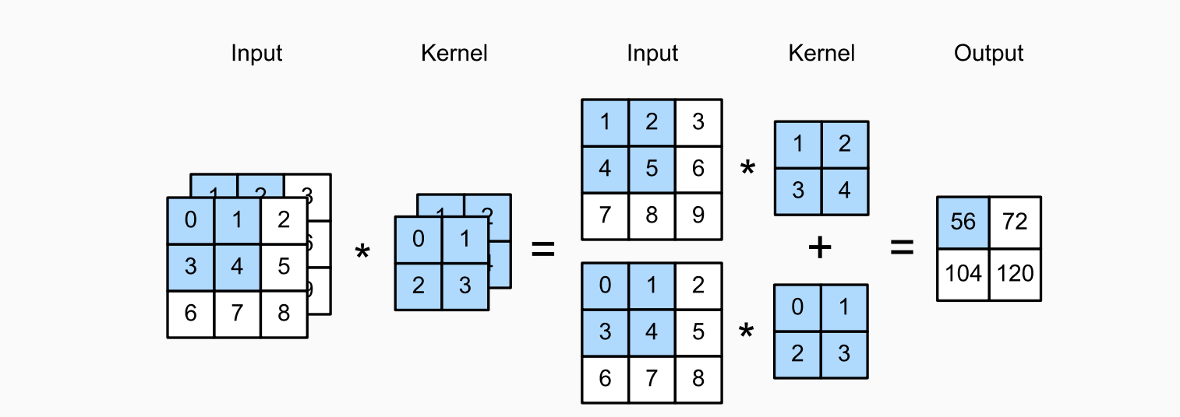
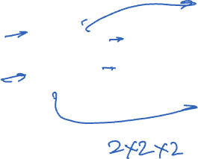
Multiple Input Channels: example

Slide 30
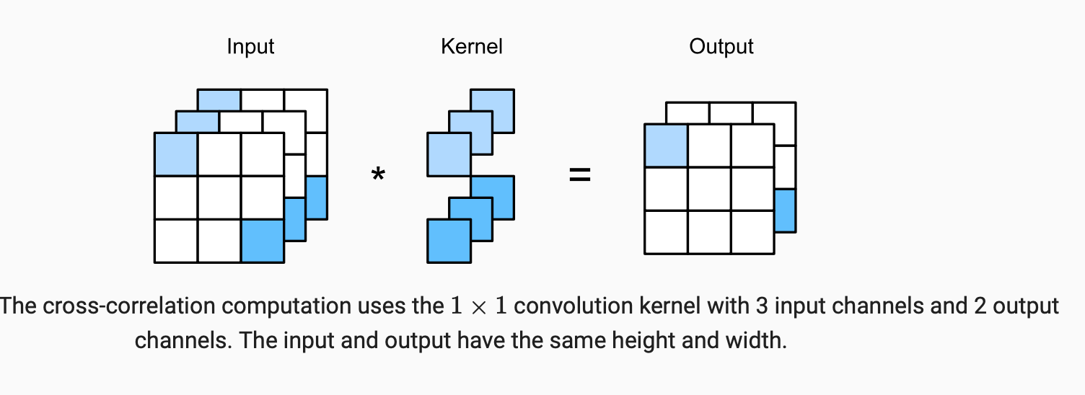
Multiple Output Channel: example (1x1 convolution)

Slide 31
CNN Channels
Channels allow us to combine the best of both worlds: MLPs that allow for significant nonlinearities and convolutions that allow for localised analysis of features.
In particular, channels allow the CNN to reason with multiple features, such as edge and shape detectors at the same time.
They also offer a practical trade-off between the drastic parameter reduction arising from translation invariance and locality, and the need for expressive and diverse models in computer vision.

Slide 32
Pooling
In many cases our ultimate task asks some global question about the image, e.g., does it contain a lesion?
Consequently, the units of our final layer should be sensitive to the entire input.
By gradually aggregating information, yielding coarser and coarser maps, we accomplish this goal of ultimately learning a global representation, while keeping all of the advantages of convolutional layers at the intermediate layers of processing.

Slide 33
CNN – deep layers
image source: http://cs231n.stanford.edu/

Slide 34
Deeper layers in CNNs
The deeper we go in the network, the larger the receptive field (relative to the input) to which each hidden node is sensitive.
Reducing spatial resolution accelerates this process, since the convolution kernels cover a larger effective area.

Slide 35
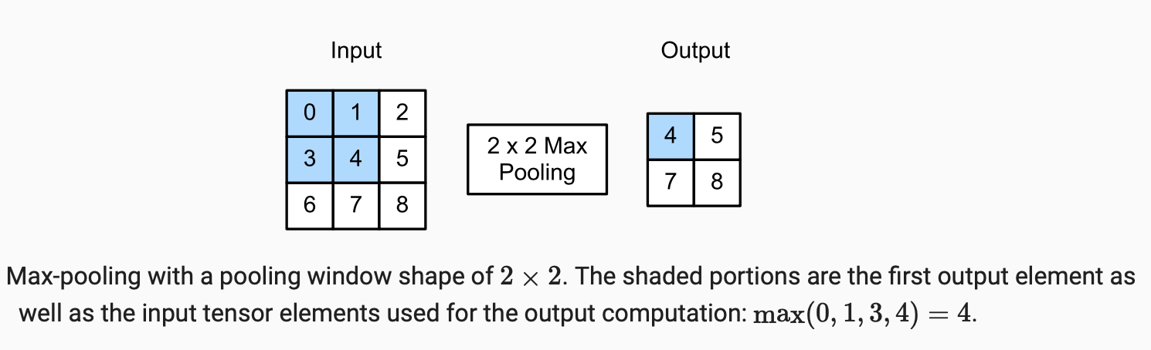
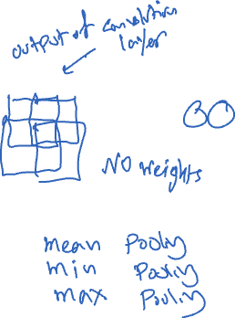
Maximum Pooling and Average Pooling

Slide 36

Pooling
Like convolutional layers, pooling operators consist of a fixed-shape window that is slid over all regions in the input according to its stride, computing a single output for each location traversed by the fixed-shape window (sometimes known as the pooling window).

Slide 37

Max-pooling and average-pooling
However, unlike the cross-correlation computation of the inputs and kernels in the convolutional layer, the pooling layer contains no parameters (there is no kernel).
Instead, pooling operators are deterministic, typically calculating either the maximum or the average value of the elements in the pooling window.
These operations are called maximum pooling (max-pooling for short) and average pooling, respectively.

Slide 38
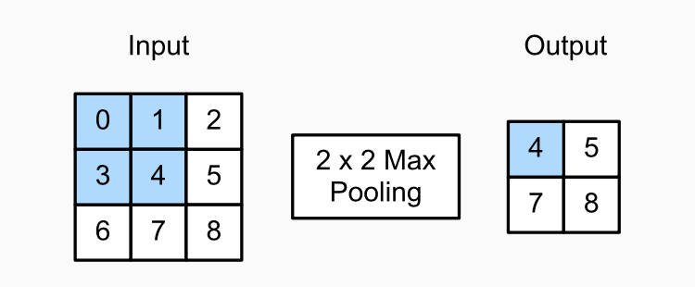
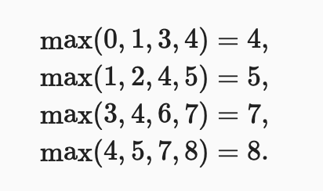
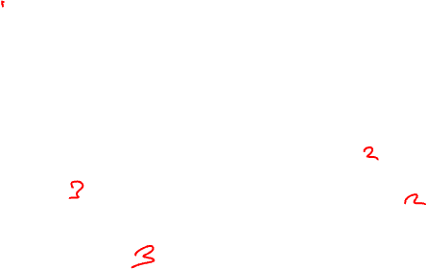
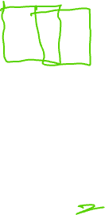
Max-pooling: revisiting the example

Slide 39
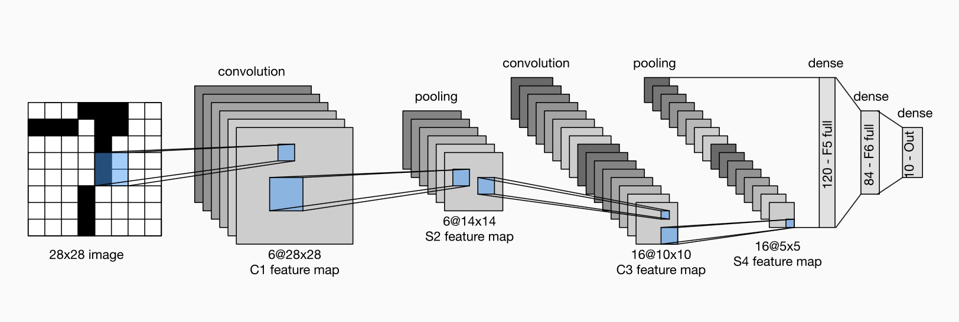
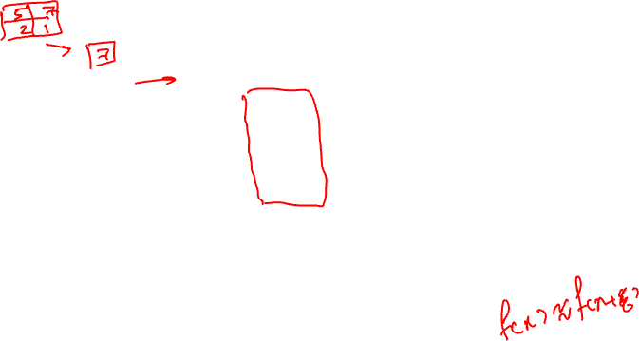
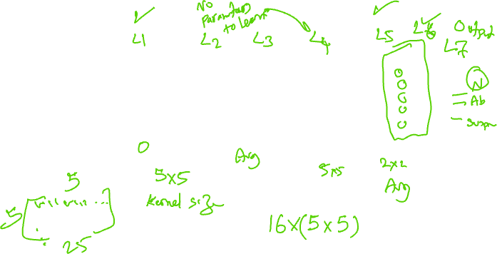
Convolutional Neural Networks: example LeNet

Slide 40
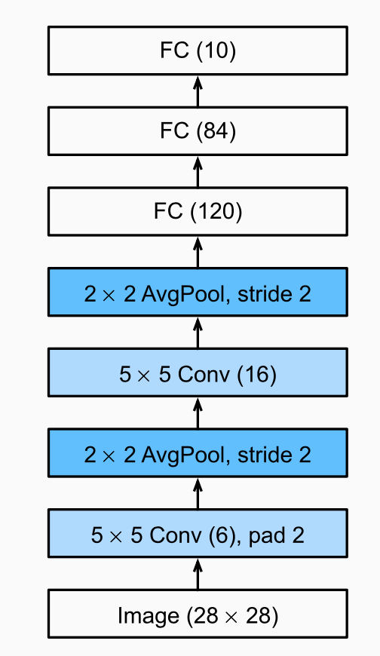

Compressed notion for LeNet-5

Slide 41
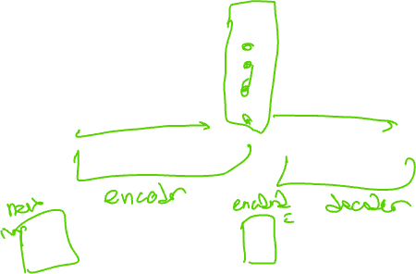
CNN Autoencoder
image source: https://towardsdatascience.com/convolutional-autoencoders-for-image-noise-reduction-32fce9fc1763

Slide 42

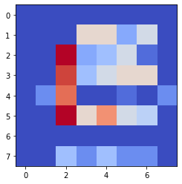
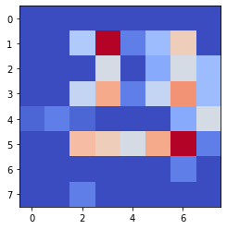
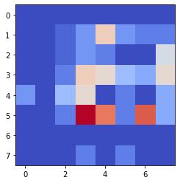

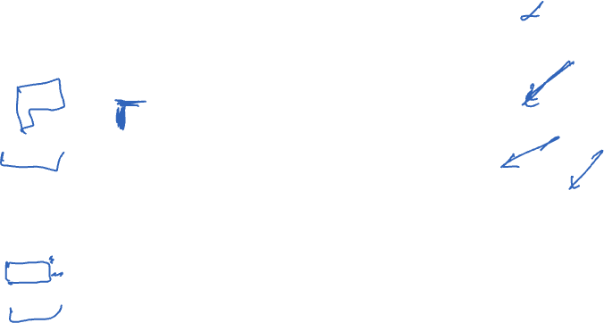
More examples
A sample filter which takes the middle areas out of data
A sample filter which takes the two white areas out of data

Slide 43
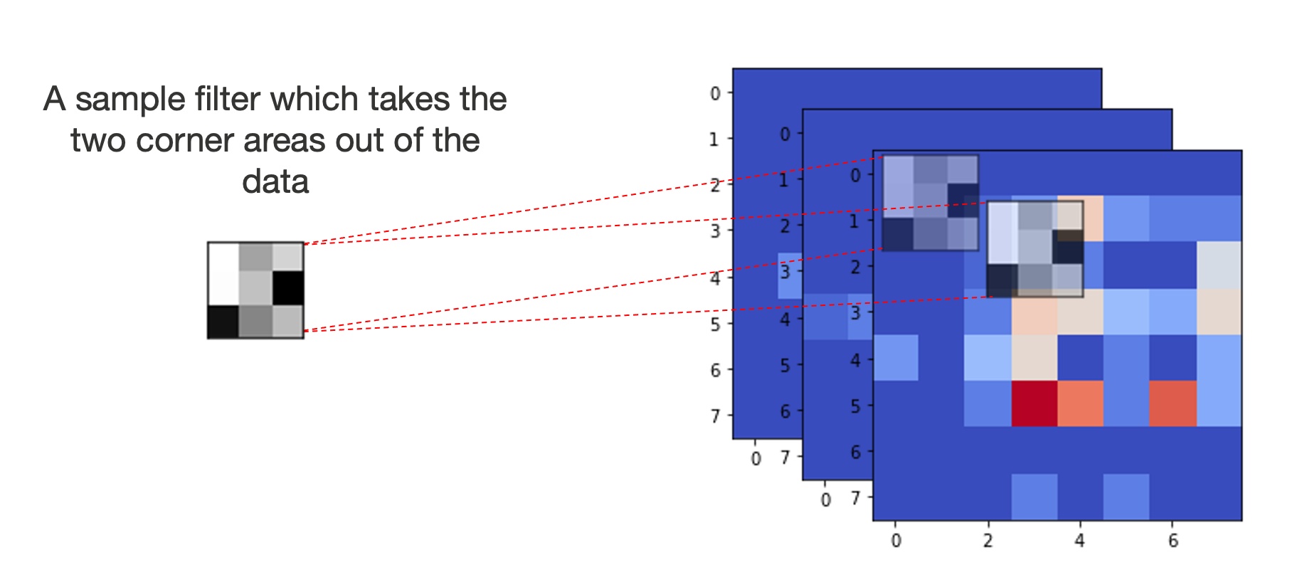
More examples

Slide 44
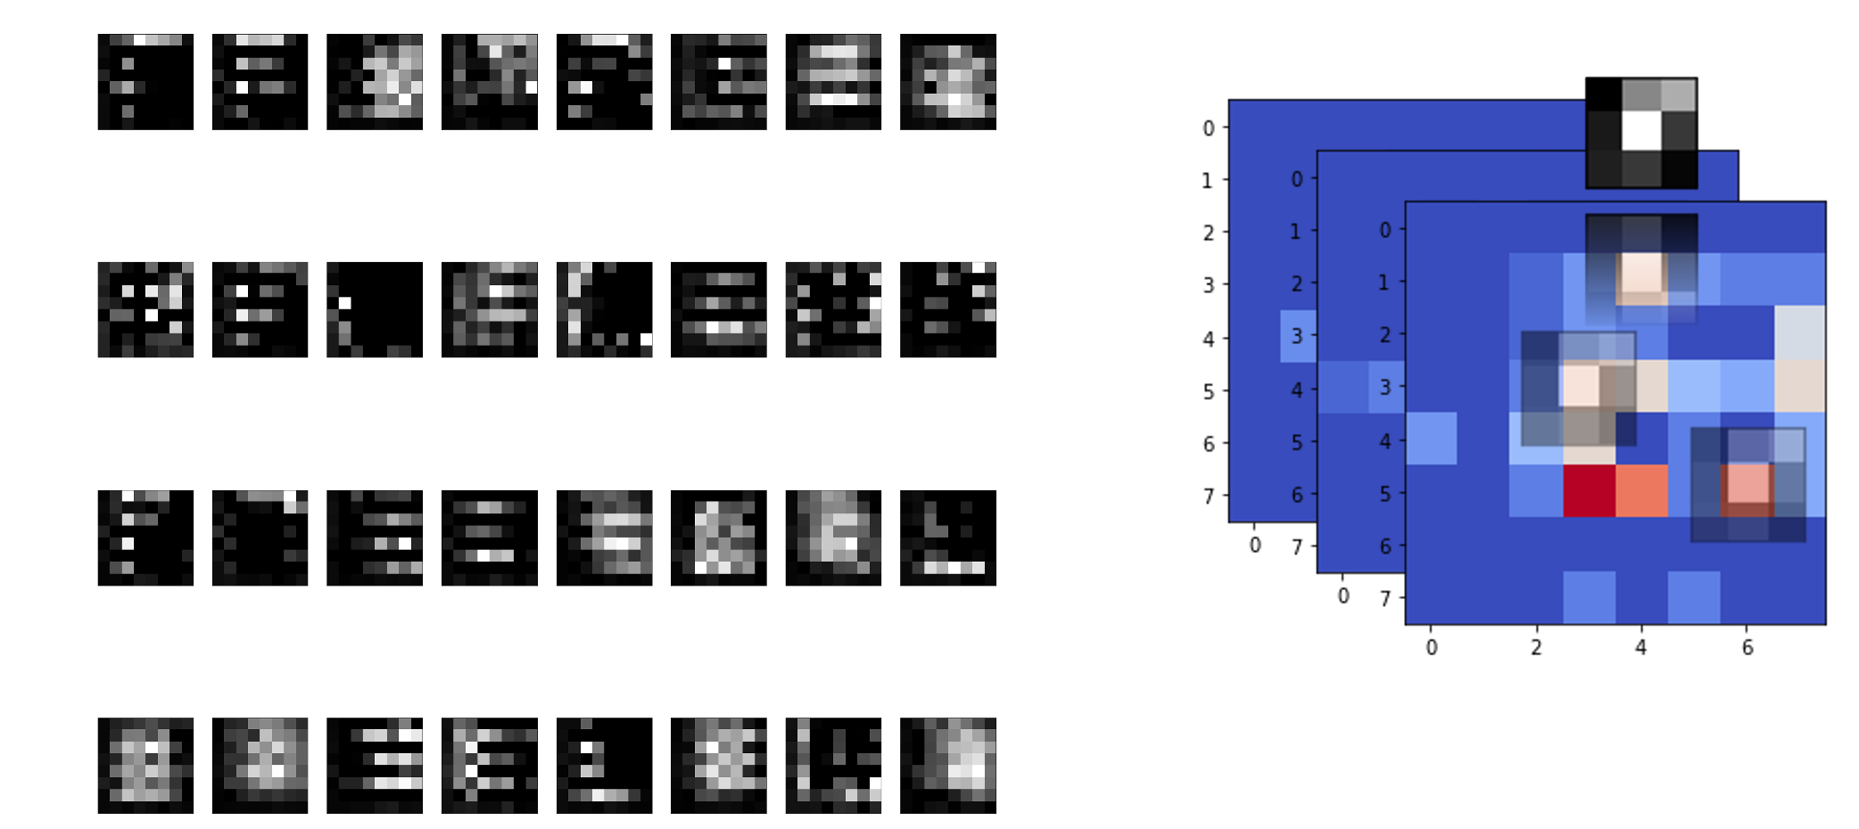
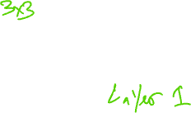
More examples – outputs of the first convolution layer

Slide 45
Revisiting the initial example
image source: http://cs231n.stanford.edu/

Slide 46
Review questions

Slide 47

Q1
In a CNN network, if a method generates results shown in section (b) from the data grid shown in section (a), what technique has been used?
12 | 10 | 3 | 2
8 | 6 | 1 | 0
4 | 7 | 5 | 7
4 | 6 | 6 | 8
12 | 3
7 | 8
(a)
(b)

Slide 48

Q2
In a CNN network, if we have the kernel shown in (a) and want to apply to the data shown (b) with a stride of 2, what padding size would you recommend?
1 | -1
-1 | 1
12 | 10 | 3 | 2
8 | 6 | 1 | 0
4 | 7 | 5 | 7
4 | 6 | 6 | 8
(a)
(b)

Slide 49
Acknowledgements
Some of the content are adapted from: Dive into Deep Learning, by Zhang, Aston and Lipton, Zachary C. and Li, Mu and Smola, Alexander J, 2021.

Slide 50
If you have any questions
Please feel free to come and see me (9th Floor, Sir Michael Uren Research Hub, White City Campus) or email (p.barnaghi@imperial.ac.uk).

